Slide 1

A Case for Superconducting Accelerators
Swamit S. Tannu*, Poulami Das*,
Mike Lewis#, Robert Krick#, Douglas M. Carmean#,
Moinuddin K. Qureshi*
Computing Frontiers, 2019
Sardinia, Italy
* Georgia Institute of Technology
# Microsoft

Slide 2
Outline
Introduction
Superconducting Accelerator Design
Technology-Aware Design
Fault-tolerant Accelerator
Final Evaluation and Conclusion

Slide 3
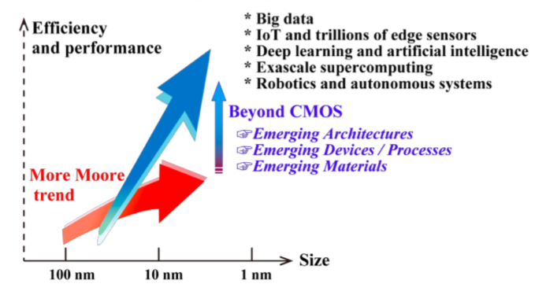
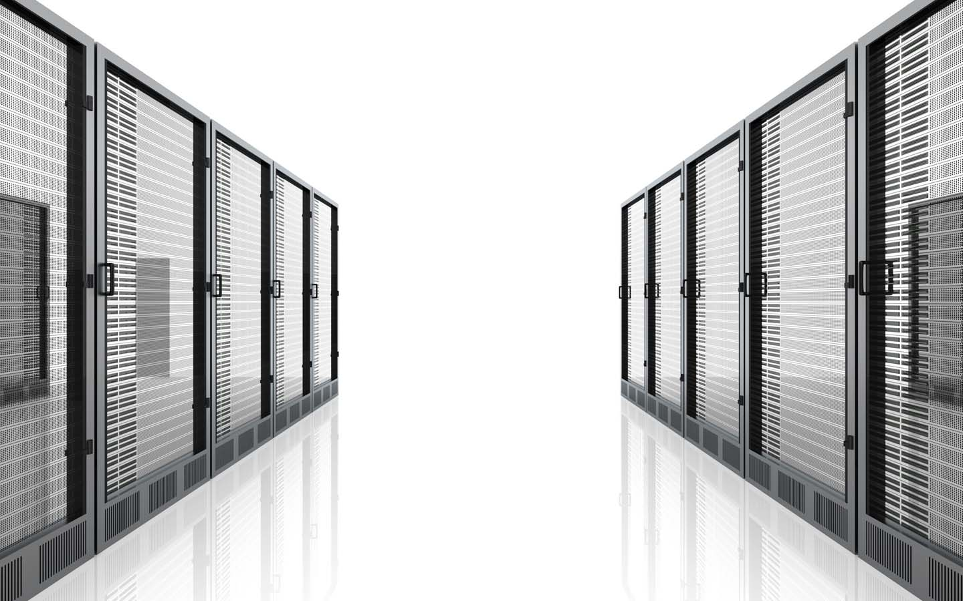







The Post Moore’s Law Era
Growing Computational needs
Superconducting technology?
Limited Power Budgets
Energy-Efficiency?
Ref: IRDS Roadmap 2017 (Beyond CMOS)
Superconducting technology is a potential alternative to CMOS
Notes:
We observe a wide range of computational devices today and the computational requirements keep growing
And these computational demands must be met within limited power budgets
Energy-efficiency of performance per unit of power dissipated is thus a key metric that current designs look forward to optimize
Since CMOS scaling has slowed down, researchers are looking at possible CMOS alternatives that can meet the growing demands for energy-efficient computing
Superconducting technology is one such potential candidate

Slide 4

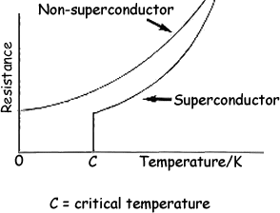
What is Superconducting Logic?
Reduce Temperature
Superconductor
Conductor
Conductor
Metal
Superconductivity
Metal
Metal
Critical Current
Current
Current
Superconductor
Insulator
Magnetic flux
Quantized
Current
Josephson Junction
Very fast switching device
Ref:https://www.globalspec.com/learnmore/materials_chemicals_adhesives/electrical_optical_specialty_materials/superconductors_superconducting_materials
Why is Superconducting logic promising?
Superconductivity can be leveraged to build fast switching devices
Notes:
Normally metals conduct electricity but offers certain resistance at normal temperatures.
However, when the temperature is reduced, certain metals offer zero resistance to the flow of current. This is called a superconductor and the current flowing through the metal when the resistance becomes zero is called the critical current of the superconductor.
This physical phenomenon is called superconductivity.
Now two superconductors separated by a thin insulating barrier can be used to construct a very high speed switching device called a Josephson Junction.
Below Ic a metal is superconducting whereas above Ic, it is resistive
Thus by controlling the critical current flowing through a JJ, it can be switched between two states
In a superconducting loop with a JJ, the magnetic is quantized i.e. it can only take integer multiple values of a single flux quanta (SFQ). Presence or absence of SFQ can be used to offer a digital abstraction.
When a JJ switches from superconducting to a resistive state, the magnetic flux through the superconducting loop containing the JJ changes by a flux quanta, generating an SFQ pulse of about 1 pico-second duration and 2 milli-volt magnitude,

Slide 5
Why is Superconducting Technology promising?
Parameter | CMOS at 300K | Superconducting at 4K
Operating Frequency | 1 | 5x
Energy (64 bit Adder) | 1 | 0.1x
Interconnect power | 1 | 0.00003x
What are the challenges?
Superconducting technology can be leveraged to build energy-efficient designs
Notes:
This technology offers very fast switching (ranging in the order of a picosecond). Thus the operating frequency is much higher than traditional CMOS
The energy dissipation is about an order of magnitude lower compared to CMOS.
The interconnect power consumption is almost negligible compared to traditional CMOS.
All these seems good but this technology is not mature and thus has several challenges. So what are the challenges?

Slide 6
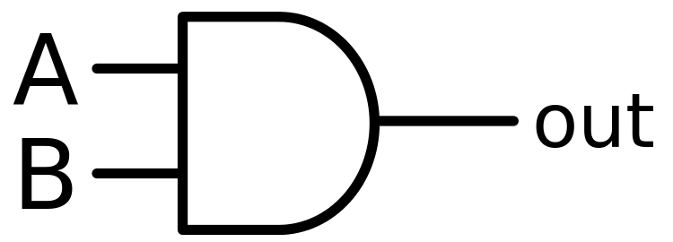
Challenges of Superconducting Technology
Low logic density
Low memory capacity
Low fanout
CMOS
Superconducting Technology
Increases circuit complexity
Superconducting technology is nascent and has several challenges
Notes:
There are few key challenges for this technology.
Not enough devices and device density
Memory capacity is too low: in the range of a few KB
Gates cannot drive each other (requires huge buffering overhead). For example, in this CMOS circuit, one AND gate can drive two other AND gates. However, this same circuit in superconducting technology requires 3 buffers. Each buffer requires 2 JJs and this leads to an increase in circuit complexity.

Slide 7
Executive Summary
Problem: Superconducting technology has potential to offer energy-efficient designs but has several challenges
Goal: Understand the technology-specific constraints and study a superconducting accelerator design
Contribution 1: System level accelerator design
  Bitcoin Mining: high computational intensity, low memory footprint
Contribution 2: Technology aware design exploration
  Optimize design to meet specific challenges of superconducting logic
Contribution 3: Tackling the reliability challenges
  Fault-tolerant superconducting design
Notes:
Now that we have understood the motivation to explore superconducting circuits, the advantages and shortcomings of the technology, here is an executive summary for the rest of the talk.
1. Our goal is to understand the technology-specific constraints and study the design of a superconducting accelerator.
2. Our first contribution is the system level design of an accelerator that fits into the design space of superconducting technology.
2. Our second contribution is optimization of this design to meet the constraints of this specific technology
3. Our third contribution is that we understand the specific reliability challenges of this technology and present a fault-tolerant design

Slide 8
What applications can benefit?
Computationally intense
Low memory footprint
Bitcoin Mining
Bitcoin Mining is a potential application that falls into this category
Notes:
Based on the specific characteristics of superconducting technology the applications that can really benefit at this point are ones that are computationally intensive and has very low memory footprint. One such application is Bitcoin mining.
Bitcoin Mining is typically used in blockchain
Blockchain: a decentralized public ledger of transactions that maintains the validity of transactions through a distributed consensus mechanism
Mining: the process of authenticating transactions, involves searching for a 32 bit key called nonce and uses double SHA 256

Slide 9

How Bitcoin Mining works?
Rewards
Bitcoin Network
Message
Key
Repeat
Try different key
Compute Hash
Yes
Hash < threshold?
No
Bitcoin Mining uses a brute force approach
Notes:
1. User receives a message from the bitcoin network and inserts a random key
2. The user then computes a hash and if this computed has is less than a certain threshold, they report to the network. Post this the user is rewarded
3. If the hash is not below the network provided threshold, the user tries a different random key.
4. Since cryptographic, the process of mining uses a brute force approach

Slide 10
Why is bitcoin mining suitable?
Message
SHA Engine
Repeated logical and arithmetic operations
Memory required only to store message and 1 constant per round
(< 300 bytes)
MESSAGE SCHEDULING UNIT (MSU)
Logical + arithmetic operations
Bitcoin
Miner
SHA-256 Engine
…
SHA Engine
COMPRESSION FUNCTION GENERATOR
(CFG)
Logical + arithmetic operations
After 64 cycles
Final Hash
256-bit Hash
Bitcoin mining has very high computational intensity and low memory footprint
Notes:
Let us understand the exact steps in bitcoin mining
A message is split and multiple 32 bit components are generated. Each cycle one of these components goes through the logical and arithmetic operations inside a compression function generator. At the end of 64 cycles, it outputs the 256 bit hash. This happens inside a single SHA engine.
Bitcoin mining uses double SHA which means two back to back SHA operations take place inside a bitcoin miner.
Thus in bitcoin mining there is repeated logical and arithmetic operations, and memory is only required to store the message and 1 32-bit constant per round giving a total of <300 bytes

Slide 11
Baseline Accelerator Design
SHA Engine
Bitcoin Miner
CoinTerra
Goldstrike 1
Performance: GH/s
Energy-efficiency:
  4 GH/J at 16 nm
Ref:
J. Barkatulla et. al “Goldstrike1: Cointerra’s first generation cryptocurrency mining processor for bitcoin”, HotChips 2015
Stage 1
Stage 1
Stage 2
Stage 2
Stage 64
Stage 128
256 bit hash
Final hash
Notes:
Each of the 64 rounds of a SHA engine can be pipelined. This effectively leads to a 64 stage pipeline.
For bitcoin mining, a similar pipeline can be designed, that comprises of 128 stages
This is exactly how Cointerra’s GoldStrike 1 design is implemented
The performance is in GH/s and energy-efficiency of a hash engine is 4 GH/J at 16 nm
We use this design as our baseline

Slide 12
System Organization
Bitcoin Network
10x energy-efficient
128 stage pipelined design
Bitcoin Found
Cold
Accelerator
at 4K
Hash Engine
Simply porting a CMOS 16 nm design gives 10x energy-efficiency improvement
Notes:
For the superconducting accelerator, we envision the system organization as shown.
The user receives a message from the network and offloads the message to the superconducting accelerator operating inside a cryogenic environment at 4 K
If a bitcoin is found, the accelerator sends a message back to the user.
This accelerator hosts multiple hash engines and each of these hash engines is the 128 stage pipelined design discussed before.
We observe that simply porting the CMOS design gives about 10x improvements in energy-efficiency

Slide 13
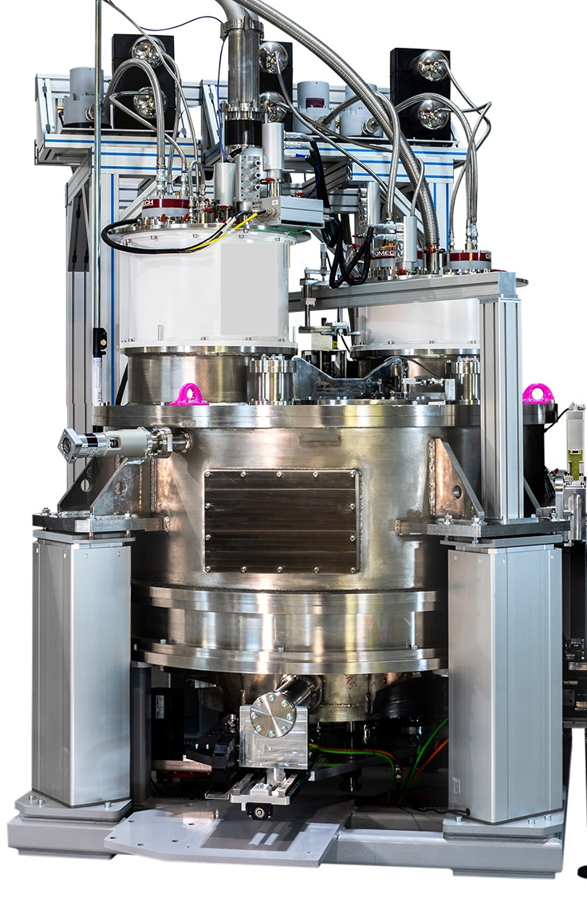

Methodology
Verilog Design
Performance
Yosys open-source synthesis tool
Netlist
Rules for JTL
JJ Complexity
Power
RQL cell lib
JJs to implement logic
JJs to implement JTLs
Cryogenic cooling
Ref: Ultra-Low-Power Superconductor Logic, Quentin P. Herr, Anna Y. Herr, Oliver T. Oberg, and Alexander G. Ioannidis Northrop Grumman Systems Corp., Baltimore, MD 21240
Notes:
We design the module in Verilog HDL and synthesize the design using the RQL cell library. RQL is a superconducting logic family.
We Yosys, an open source synthesis too that accepts custom gate libraries.
We post process the output netlist and insert buffers as required.
This enables us to determine the JJ complexity. JJ complexity may be defined as the total number of JJs required to implement the logic and JJs required for interconnects.
Performance, Power and Area are dependent on the JJ Complexity
We determine the performance by analyzing the critical path of the design and account for 20% skew. In this design, once the pipeline is full, an output hash is generated every cycle.
To compute the total power consumption we must account for the cooling overheads since the system operates at cryogenic temperatures.

Slide 14
Design Optimizations: Adders
Ripple Carry Adder
Kogge Stone Adder
Why should we optimize adders?
-50% of JJ complexity
Critical for Performance
Slow
Lower Complexity
Low Fanout
Fast
Higher Complexity
High Fanout
Tree-based adders are not energy-efficient because of JTL overheads
Notes:
1. Why should we optimize for adders?
2. They account for 50% of JJ complexity and are on the critical path, hence critical for performance.
3. In the baseline design we use ripple carry adders which are slow but has lower complexity and fanout
4. Kogge stone adders on the other hand are fast but has higher complexity and fanout. As a result when we design the same accelerator with KSAs, we observe that the energy efficiency decreases
5. High fanout requires large number of buffers in superconducting logic, which essentially reduces the energy-efficiency.
6. Thus we want to use adders that offer high performance but has lower fanout

Slide 15
Modules in a SHA Engine
Compression Function Generator
Message Scheduling Unit
Majority of additions in a SHA engine are back-to-back and can be fused
Notes:
If we look at the major components of a SHA engine pipeline, we observe that most of the additions are back to back and the intermediate results are not consumed at more than one location. Thus, these additions can be fused

Slide 16

Design Optimizations: Adders (Continued)
Carry Save Adder
Fast
Low Fanout
Energy-efficiency can be improved by accounting for fanout overheads
Notes:
We use a carry save adder that is fast as well as has lower fanout
As a result, the same superconducting accelerator designed using carry save adders is 1.2x more energy-efficient compared to its counterpart designed using RCAs.

Slide 17
Design Optimizations: Registers
Superconducting Delay Line
Why should we optimize registers?
Delay Line Memory
45 % of JJ complexity
3 working registers
Deterministic consumption
Logic
Logic
Stage N
Stage (N+1)
1.2x energy-efficient over baseline superconducting accelerator
Registers for storing data with deterministic use can be replaced by delay lines
Notes:
Why should we optimize registers?
Registers account for 45 % of JJ complexity
We observe that only 3 registers are updated per pipeline stage whereas the remaining registers are just used to transport register values that are consumed in future stages.
So we use delay lines. Traditional delay lines some kind of a delay element. In superconducting logic a series of JTLs can be considered as the delay element. These delay lines can be used to send data from the producer to the consumer.
So if we look at the entire pipeline and group the registers into working and storage registers, in the optimized design, the storage registers are eliminated and replaced with delay lines. The benefit comes from the lower device counts of delay lines. Delay lines require 4 JJs per bit whereas registers require 12 JJs per bit

Slide 18
What are the Reliability Challenges?
Fabrication defects:
  Occurs during fabrication
  Similar to stuck-at-faults
Device parameter variation faults:
  Reduced noise margin
Operational environment faults:
  Flux trapping: trapping of stray magnetic fields due to non-uniform cooling
Error
Certain faults are neither transient nor permanent
Notes:
Besides the challenges we have already discussed, Superconducting Technology also suffers from reliability challenges
There are mainly three types of faults:
Fabrication defects that are similar to stuck at faults in CMOS
Device parameter variation faults: for instance changes in device parameters can lead to reduced noise margins and erroneous results are observed
The third type of Fault: operational environment fault such as Flux trapping is interesting because it is neither transient nor permanent. The granularity of the fault is larger. Flux trapping results from non-uniform cooling which traps stray magnetic fields in the JJ circuits
The faults remain between two cool down cycles but may appear at different locations across different cool down cycles.

Slide 19
Fault Tolerant Design
SHA engines have very high Architectural Vulnerability Factor (AVF)
Logic in pipeline stages is similar
Can Sparing help?
Fault-tolerant superconducting miner can be designed with spare and bypass logic
Notes:
SHA engines have very high architectural vulnerability factor due to the entropy maximization property of the algorithm
Even if a single fault exists anywhere in the circuit, the probability that the output hash is incorrect is about 99%
Thus, we look as possible mechanisms to design the same accelerator in a fault tolerant way
We observe that logic in all the stages are similar. This leads us to think how can sparing help
We modify the design by adding an extra stage and a bypass logic that can bypass a faulty stage.
This design allows us to run some built in self tests that can detect a faulty stage and can tolerate a fault anywhere within a stage.

Slide 20
What is the level of fault-tolerance?
Mux failure in any of the bypass logic can cause system failure: Add redundant mux
5-6 orders of magnitude improvement in system reliability
Notes:
One observation is that if a mux inside the bypass logic fails anywhere in the design, the entire hash engine fails
Thus we also add a redundant mux that can tolerate fault in the muxes
Our evaluations show 5-6 orders of magnitude improvement in system reliability

Slide 21
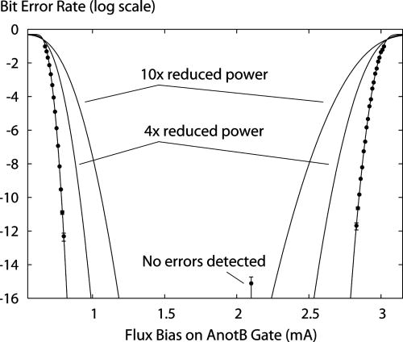
A Better-than-Worst-case design
Lower I_{c} leads to reduced noise margin and more errors
Designers choose I_{c} conservatively
But our design is fault-tolerant
We operate at lower I_{c}
Ref: Ultra-Low-Power Superconductor Logic, Quentin P. Herr, Anna Y. Herr, Oliver T. Oberg, and Alexander G. Ioannidis Northrop Grumman Systems Corp., Baltimore, MD 21240
A fault tolerant design functional at lower Ic improves energy efficiency

Slide 22
Final Evaluations
CMOS 16 nm
Superconducting Unreliable
Superconducting Reliable

Slide 23
Conclusion
Design of a superconducting accelerator that fits into the technology constraints
Perform technology specific optimizations to reduce device cost and overcome fanout challenges
Present a fault tolerant design to overcome operational environment faults

Slide 24
Thank you!
Questions?

